Slide 1


Alexandra Wabatagore
CEO and Founder
alexandrawabbs@gmail.com
+263771127760

Slide 2
PROBLEM :THE RISE OF CYBER FRAUD IN HARARE , ZIMBABWE AS 96% OF FINANCIAL TRANSACTIONS ARE CONDUCTED ONLINE
The Harare Institute of Technology lost about $24 million zimbabwean dollars after its payment system was hacked by one of its software developers .
www.herald.co.zw

Slide 3

SOLUTION .
Intrusion detection and prevention system using artificial intelligence to detect suspicious activities and generate alerts when they are dectected and prevent intrusions .

Slide 4
VALUE PROPOSITION
To provide high quality and user friendly artificial intelligence cyber security softwares, (systems ) ,cybersecurity services and forensic services to customers thereby ensuring a cyber crime free environment .

Slide 5
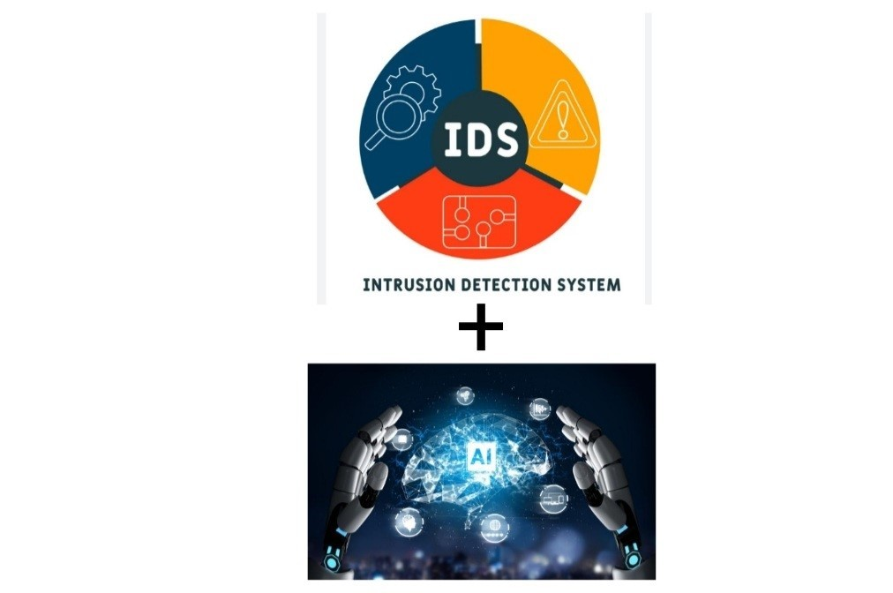
UNDERLYING MAGIC
Our solution will be different since it will prevent obfuscation ( encoding ) , IP fragmentation ,denial of service and application and account hijacking as these are techniques used by hackers to evade security controls . It will be AI based .

Slide 6
BUSINESS MODEL
Unit cost of cybersecurity and forensic service consultation = $2000 USD
Intrusion detection and prevention system cost ranges from $5000 to $15 000 USD
Will market and distribute our products and services using the following channels :
Website.
Professional social media platforms .
Partnerships.
Brokers .

Slide 7
GO TO MARKET PLAN
Will start marketing our products and services in Harare and will be targeting the following institutions and organisations :
Learning institutions (Universities and Schools )
Health care institutions
Online money transfers and payment platforms

Slide 8


COMPETITIVE ANALYSIS
Use of artificial intelligence to ensure the system prevents obfuscation ( encoding ) , IP fragmentation ,denial of service and application and account hijacking as these are techniques used by hackers to evade security controls.
Locally based to help with technical issues and trouble shooting .
There would be huge discounts for healthcare institutions ,universities and schools especially those in remote areas and under developed areas .

Slide 9
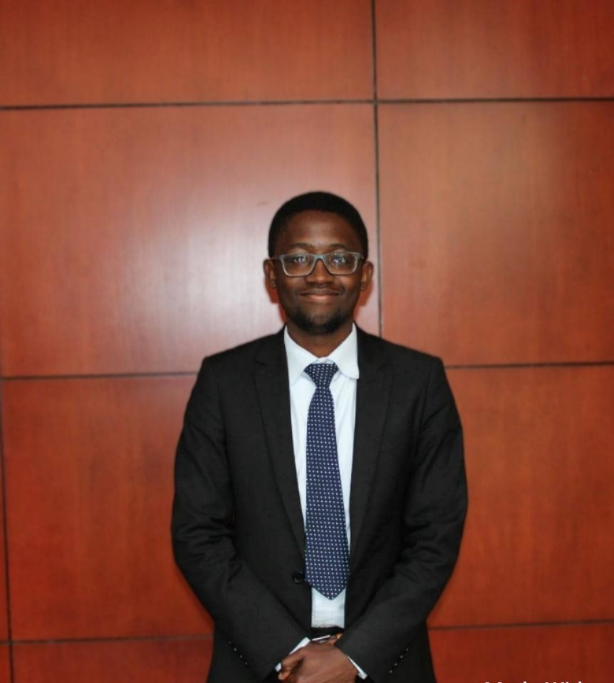
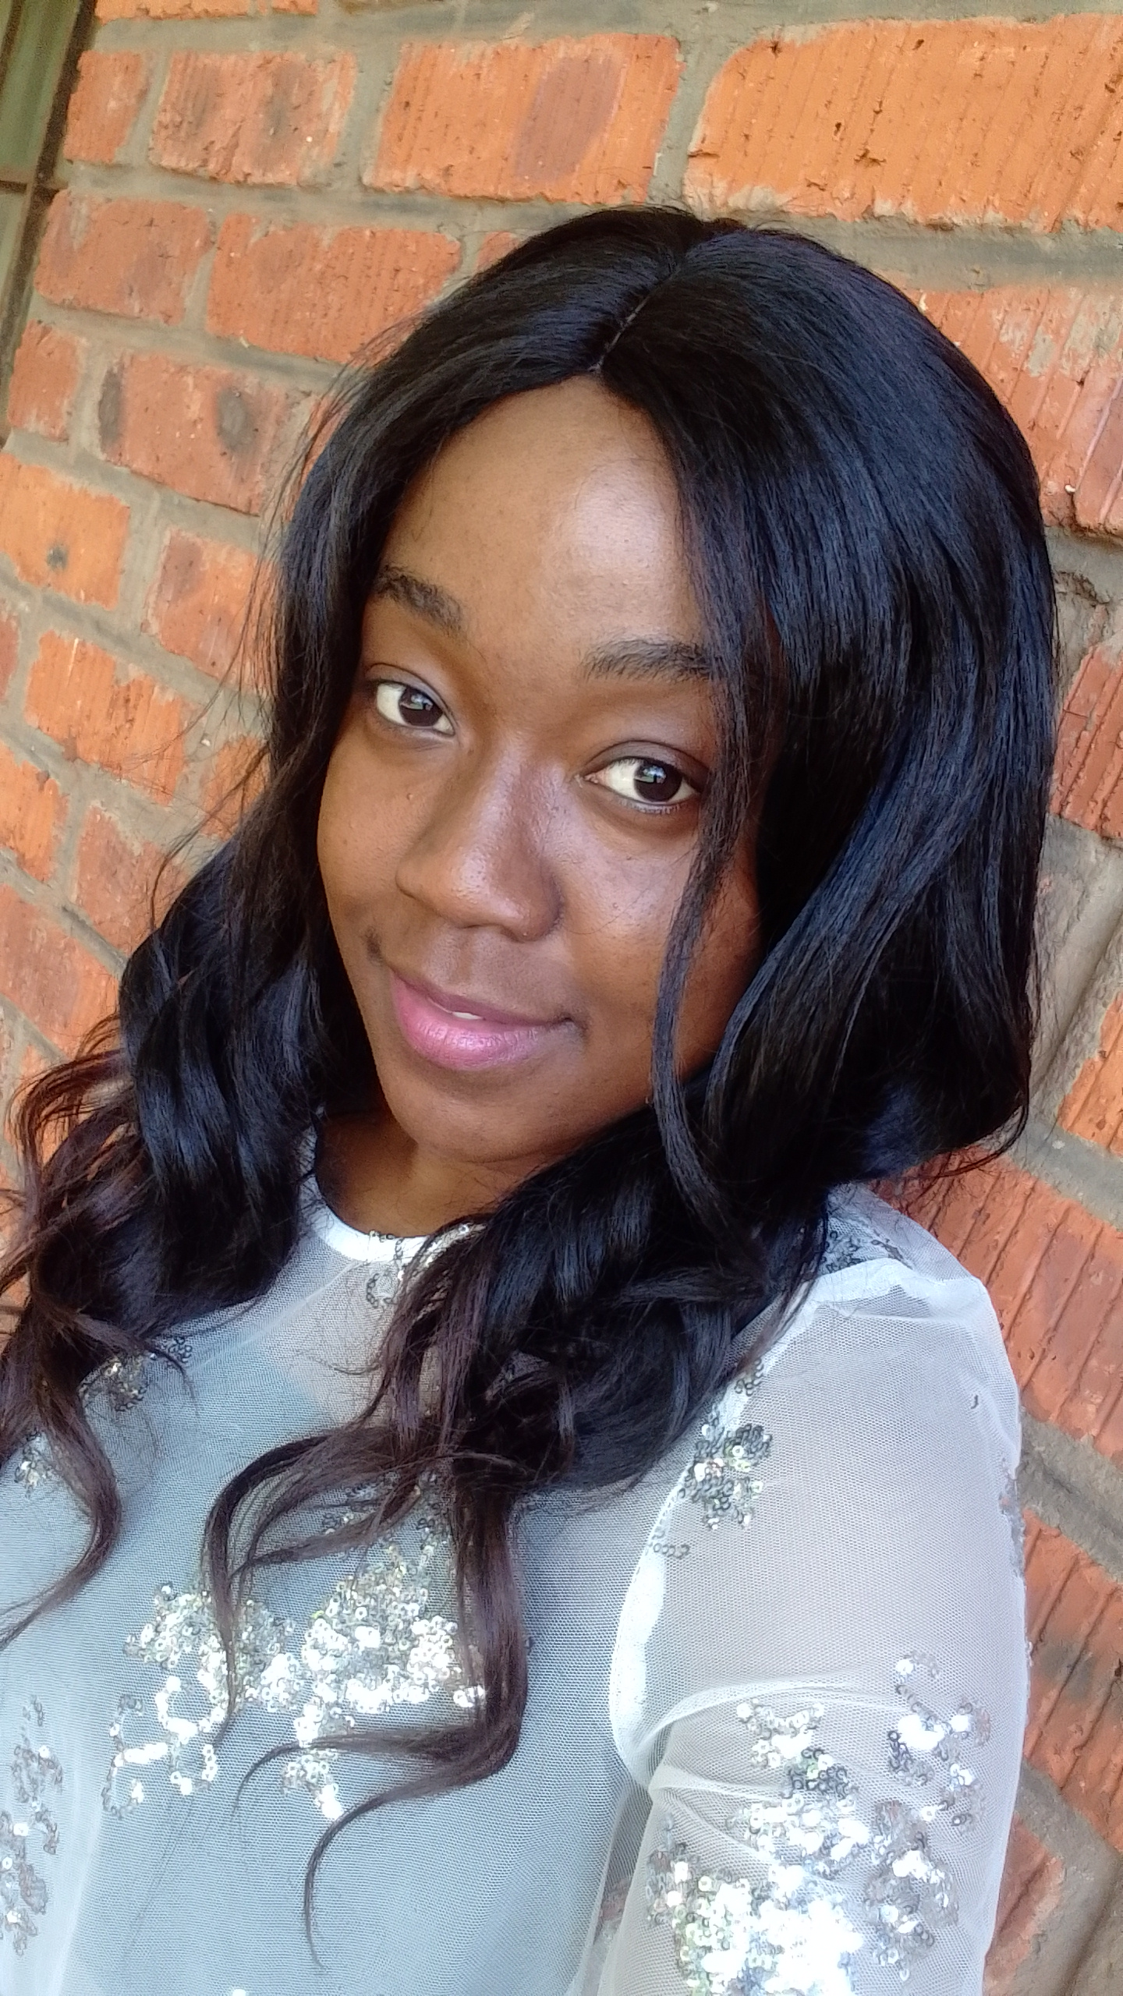
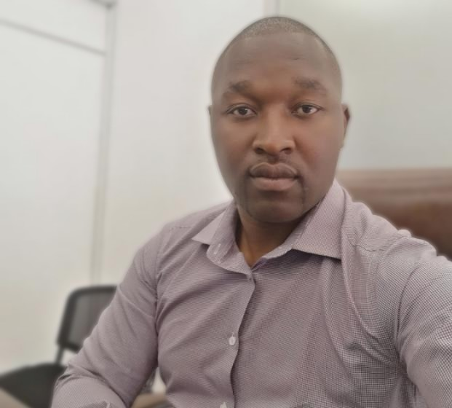
MANAGEMENT TEAM
Wayne Mureverwi
Digital Forensic Scientist and Software Developer
Alexandra Wabatagore
CEO and Founder
Digital forensic scientist
Tarbaby Banda
Senior Software Engineer

Slide 10
FINANCIAL PROJECTIONS
Targeted total revenue per month = $5000
Variable cost =$2000
Fixed cost =$1000
BREAK EVEN POINT = [Fixed cost /(Revenue per unit -Variable cost per unit )]
=0.33333

Slide 11
CURRENT STATUS ACCOMPLISHMENTS TO DATE TIMELINE .
System Development now 40%.
Gathered all information about licencing and requirements for registering the company.
Making some connections with top companies for partnerships if posible and other brokers for future marketing .

Slide 12
KEY METRICS
Net profit from sales and offering of services in 3 months , 6 months , and 12 months
Customer Lifetime Value in 3 months , 6 months and 12 months
Customer Satisfaction score in 3 months , 6 months and 12 months

Slide 13
WHAT WE ARE ASKING FOR ?
$ 30 000 Canadian dollars to cover the following costs :
Registering of company and operating licence payments .
Official Website development .
Tools for artificial intelligence development .
Hardware such as high processing speed computers and servers .
Purchase of digital forensics and cyber security tools .

Slide 14



Thank you.

